Slide 1

Credit Risk Analysis by Classifying Defaulters and Segmentation of Customers
Sanket Dilip Dayama
sanket.dmd9@gmail.com

Slide 2
Exploratory Data Analysis
Performed Univariate analysis and used “square-root transformation” to normalise the data.
Performed Bivariate analysis to find the relation between the variables with scatter plots and bar plots.
Income has a direct correlation with age, debt-income employment are negatively correlated, Highest defaulters in level1 education w.r.t debt-income.
Used “SMOTE” to up-sample the minority class.

Slide 3
Classification Model
RandomForest Algorithm was used by simple split and hyper-parameter tuning by Grid Search.
Precision and Recall were considered as evaluation metrics to check the defaulters.
Recall could be considered as an important metric because our objective to identify the defaulters which could result in loss.

Slide 4
Evaluation
Simple Split
Accuracy: 76%
Precision: 44
Recall: 30
F1 Score: 37.5
Hyper-parameter tuning
Accuracy: 78%
Precision: 52
Recall: 42
F1 Score: 47

Slide 5
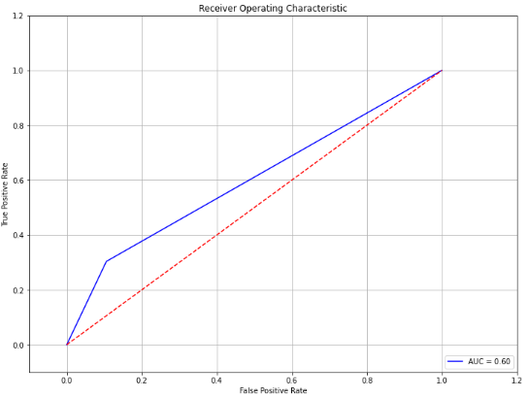
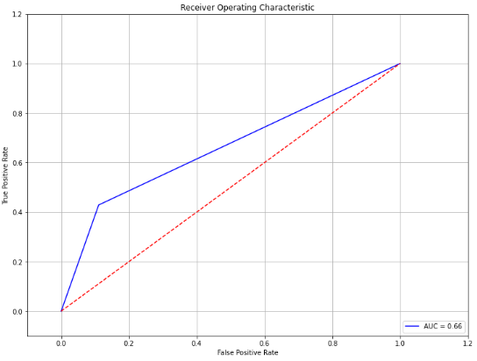
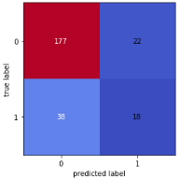
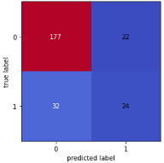
Evaluation
Simple Split: ROC Curve
Confusion Matrix
Hyper-parameter: ROC
Confusion Matrix

Slide 6
Customer Segmentation
K-Means Algorithm was used to create clusters amongst the variables like age, employment, debt to income ratio and income.
Elbow method was used to determine the optimal number of clusters.
Features were square-root transformed for normalisation and scaled the data with standard scalar to make it unitless.

Slide 7
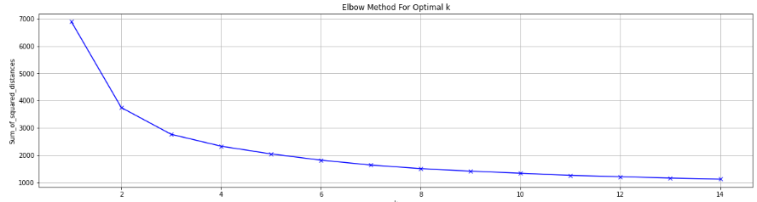
Elbow method
Elbow method was used to get optimal k clusters which was taken as k=3.

Slide 8
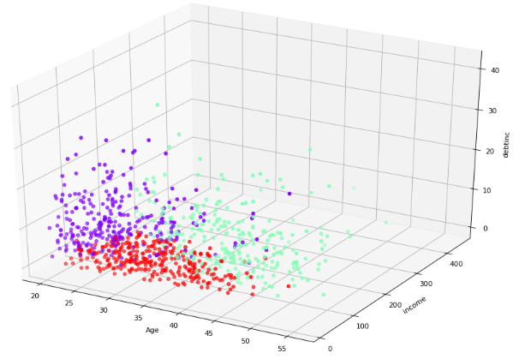
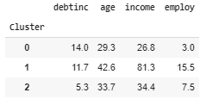
Clusters
With three clusters considering Age, Income and debt-income ratio, increase in age results in less debt-income ratio which is lowering the credit risk.

Slide 9
Conclusion
The middle-age group(33.7) has the lowest credit risk as observed in the graph and in the report which makes them the perfect customers and can re-pay the loan.
The highest risk is associated with the young group(29.30) with high debit-income ratio and less employment thus less income.
The RandomForest algorithm predicted the chance of finding the defaulter with an accuracy of 78 %.

